Slide 1
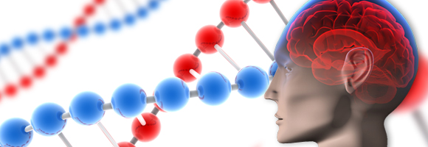
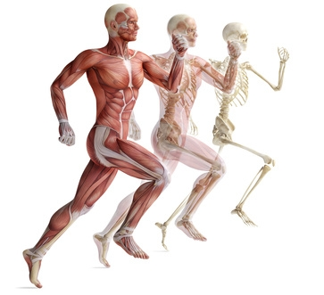
Life Processes
MRS
GREN

Slide 2
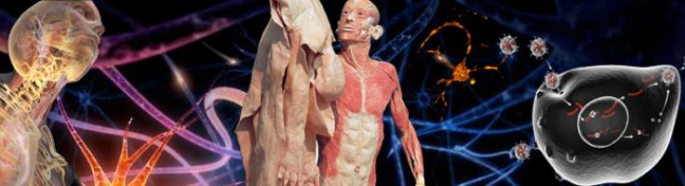

By the end of today’s lesson you will:
Know that cells carry out life processes to survive.
Be able to identify life processes:
Describe how some non-living things carry out some life processes but only living creatures can carry out them all.

Slide 3
Characteristics of Life.. What makes something “Living”- Brainstorm.

Slide 4
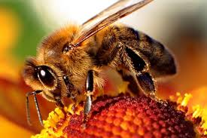

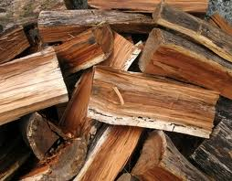
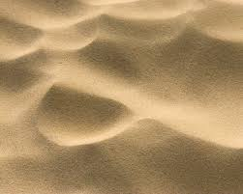
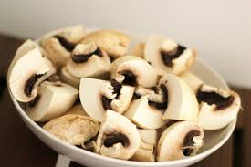
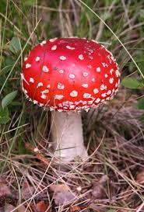
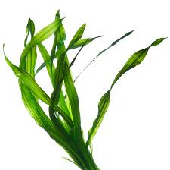
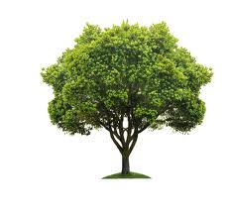
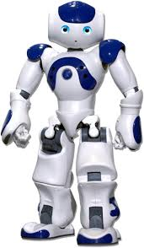
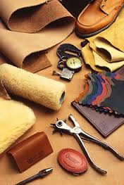
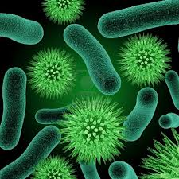
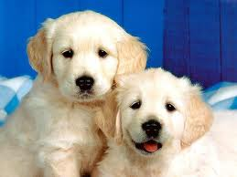
Living or non-living?

Slide 5
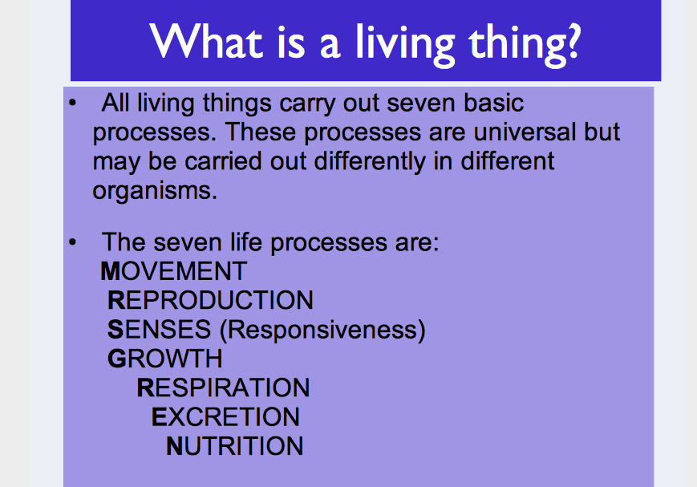

Slide 6
Some non-living things may be able to carry out SOME of these processes, however only living things are able to carry out ALL of the processes.

Slide 7
How about now
Living or non-living?

Slide 8
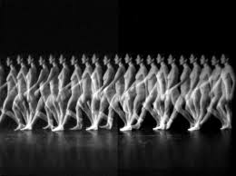
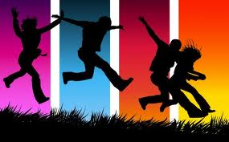
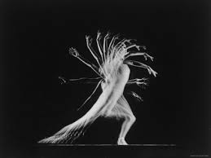
1- Movement
This is defined as the ability to move. It is also termed locomotion.
Humans use muscles and a skeleton to help them move.

Slide 9
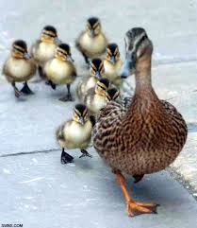
2- Reproduction
This is the process by which new individuals (offspring) are produced.
If it was not for reproduction then the species would die out.
Humans reproduce sexually, which need females and males to occur.
Some animals and parents carry
out asexual reproduction in which
one parent is required.

Slide 10
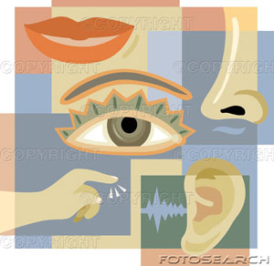
3- Senses (Responsiveness)
This is the ability to respond to
stimuli or changes in the
environment using senses.
Humans have 5 senses - sight, hearing, smell, taste, and touch. These perceptions results from information for our eyes, nose, ears, skin and taste buds.

Slide 11
Some of our responses to changes in our environment are involuntary (we have no control over them) For example: Blinking.
Most reflex actions help to prevent us form getting hurt. Other responses like the fact that we sweat when it is hot is involuntary.
Some responses can be voluntary such as answering a phone when we hear it ring.

Slide 12
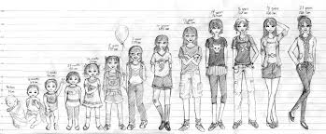
4- Growth
This is defined as an increase in size or number of cells.
Like most animals humans stop growing when they reach adulthood.
As human grow from infants to adults certain part grow at different rates, for example a babies brain doubles in size during their first year but then remains that size.

Slide 13
5- Respiration
This is the process by which we get energy from food.
This process occurs inside our cells. Energy is not made; it is released from glucose (sugar) by oxidation.
Simply, we use glucose (sugar) that is obtain via digestion and oxygen that it taken into our bodies by breathing to release energy.
The energy produced is used by cells to divide and move around the body.

Slide 14
6- Excretion
This is the process of the removal of wastes produced by our cells, not the removal of undigested food.
The main excretory organs are your lungs, skin and kidneys.
Lungs excrete carbon dioxide produced by cell respiration.
Skin contains sweat glands that help remove excess salt via sweat
Kidneys excrete nitrogenous wastes which are produced as a by product of protein breakdown in the cells.

Slide 15
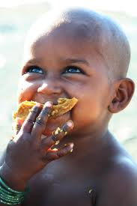
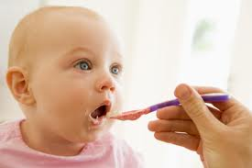
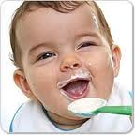
7- Nutrition
This is the ability to obtain and use food to produce energy and for growth and repair of cells.
Humans ingest food via their mouths and then food is digested and absorbed.

Slide 16
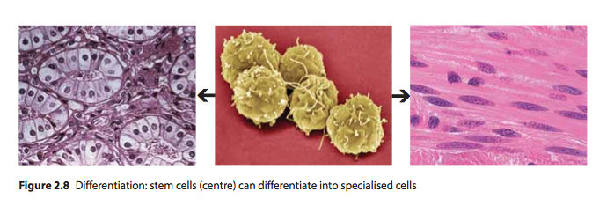
All Living things also have ….. Cells!
There is one more process that is specialised to humans.
Differentiation!

Slide 17
There are over 200 different types of cells in the human body, yet all of these different cell types came from the one original fertilised egg cell.
The different cell types arise by differentiation.

Slide 18
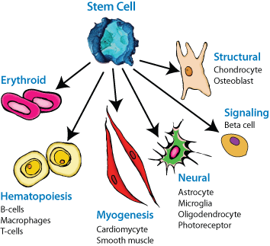
Differentiation is the process by which unspecialised cells become specialised for particular functions,
such as; bone cells,
muscle, child to adult
cells and nerve cells.

Slide 19
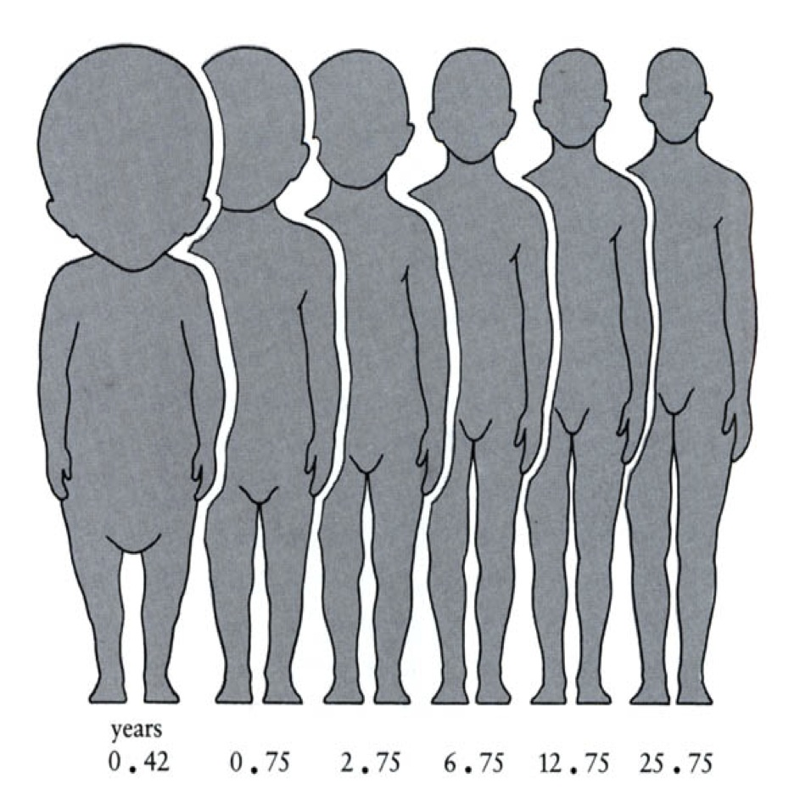

Slide 20
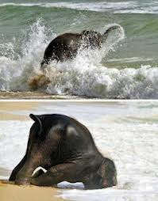
Now onto a practical ☺

